Slide 1
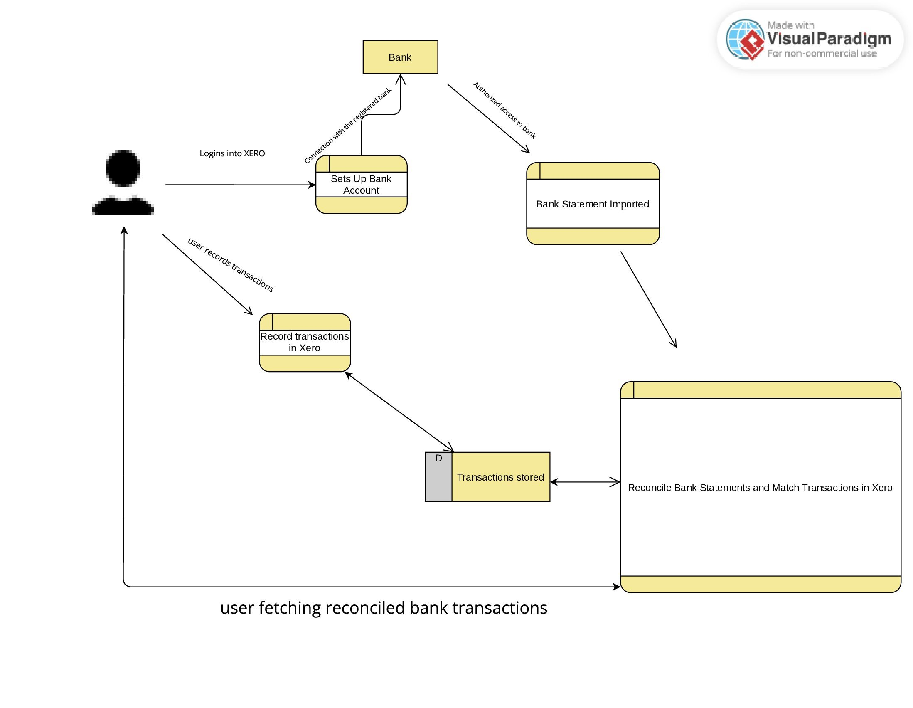
5.23 Reconciling Bank Statment

